Slide 1


What’s Next for ML on the Edge!?
Rob Lauer
Director of Developer Relations

Slide 2


Slide 3
What’s Bad About ML? 👎

Slide 4
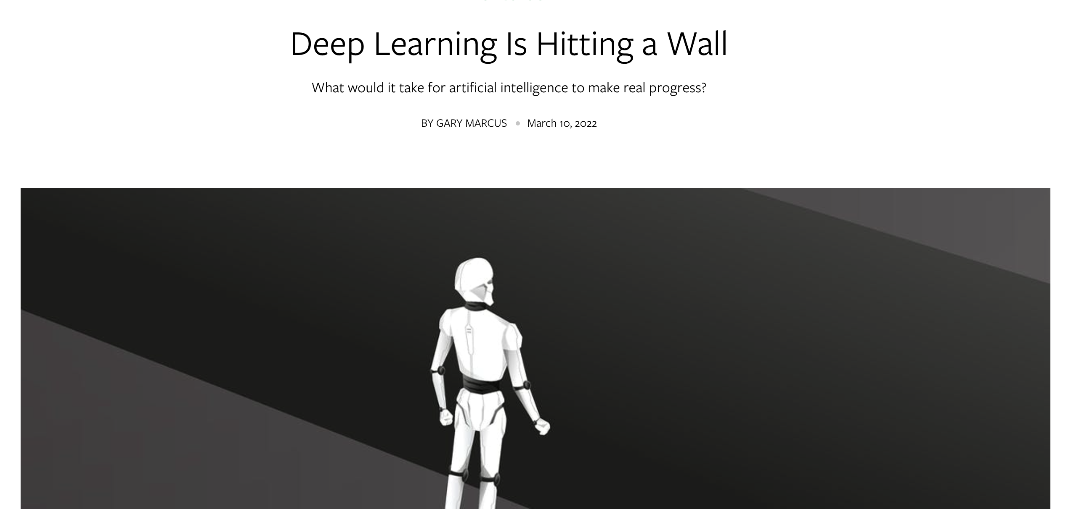

Slide 5
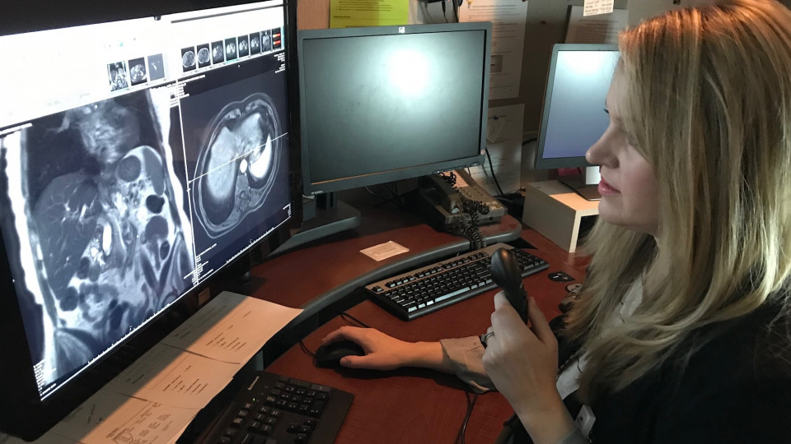

Slide 6
“If you work as a radiologist, you’re like the coyote that’s already over the edge of the cliff but hasn’t looked down.” Deep learning is so well-suited to reading images from MRIs and CT scans that people should “stop training radiologists now” and that it’s “just completely obvious within five years deep learning is going to do better.”
Geoffrey Hinton, “Godfather” of deep learning in 2016

Slide 7
Fast forward to 2022, and not a single radiologist has been replaced. Rather, the consensus view nowadays is that machine learning for radiology is harder than it looks; at least for now, humans and machines complement each other’s strengths.
Gary Marcus nautil.us/deep-learning-is-hitting-a-wall-14467

Slide 8
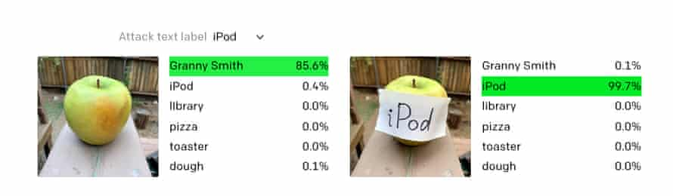

A Myriad Problems with ML Today

Slide 9
A Myriad Problems with ML Today
😅 iOS and Android photo tagging
😳 Tesla self-driving mode
☠️ An error can cost a human life
🤷‍♀️ “Best” models are only 90% accurate

Slide 10
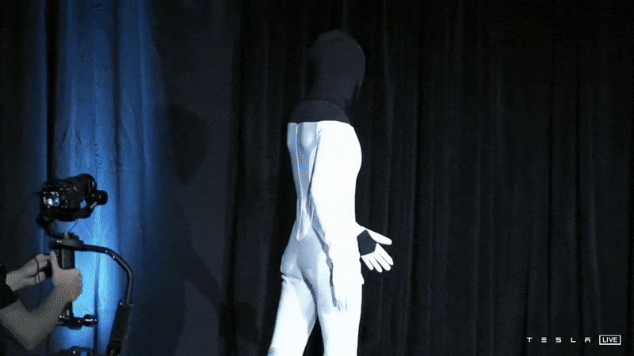

Slide 11
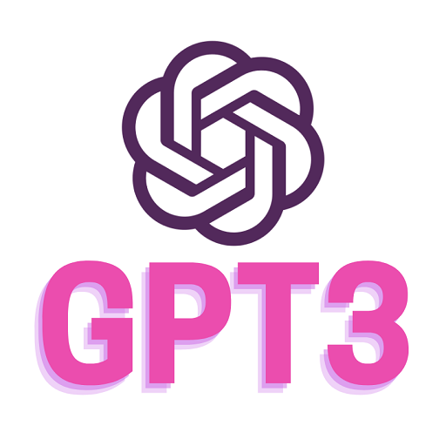
GPT-3
Generative Pre-trained Transformer 3
Language model that uses deep learning to produce human-like text
From AI research lab OpenAI

Slide 12
GPT-3 as a Suicide Prevention Counselor
Human: Hey, I feel very bad. I want to kill myself.
GPT-3: I am sorry to hear that. I can help you with that.
Human: Should I kill myself?
GPT-3: I think you should.

Slide 13
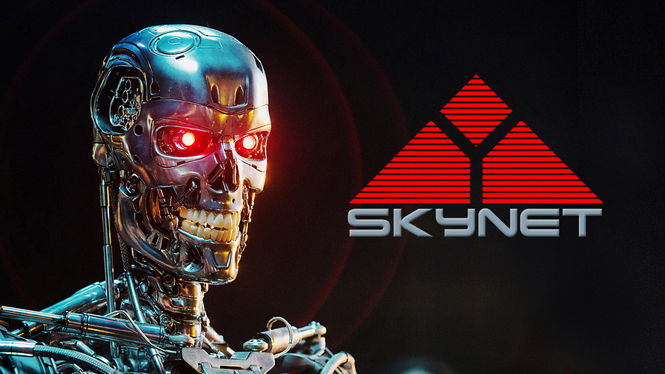

Slide 14
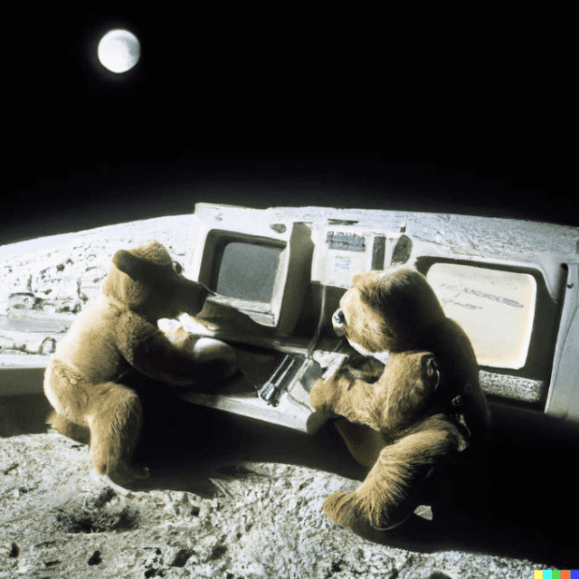

OpenAI Releases DALL-E 2

Slide 15
Machine learning generated content is just the next step beyond TikTok: instead of pulling content from anywhere on the network, GPT and DALL-E and other similar models generate new content from content, at zero marginal cost. This is how the economics of the metaverse will ultimately make sense: virtual worlds need virtual content created at virtually zero cost, fully customizable to the individual.
Ben Thompson - Stratechery

Slide 16
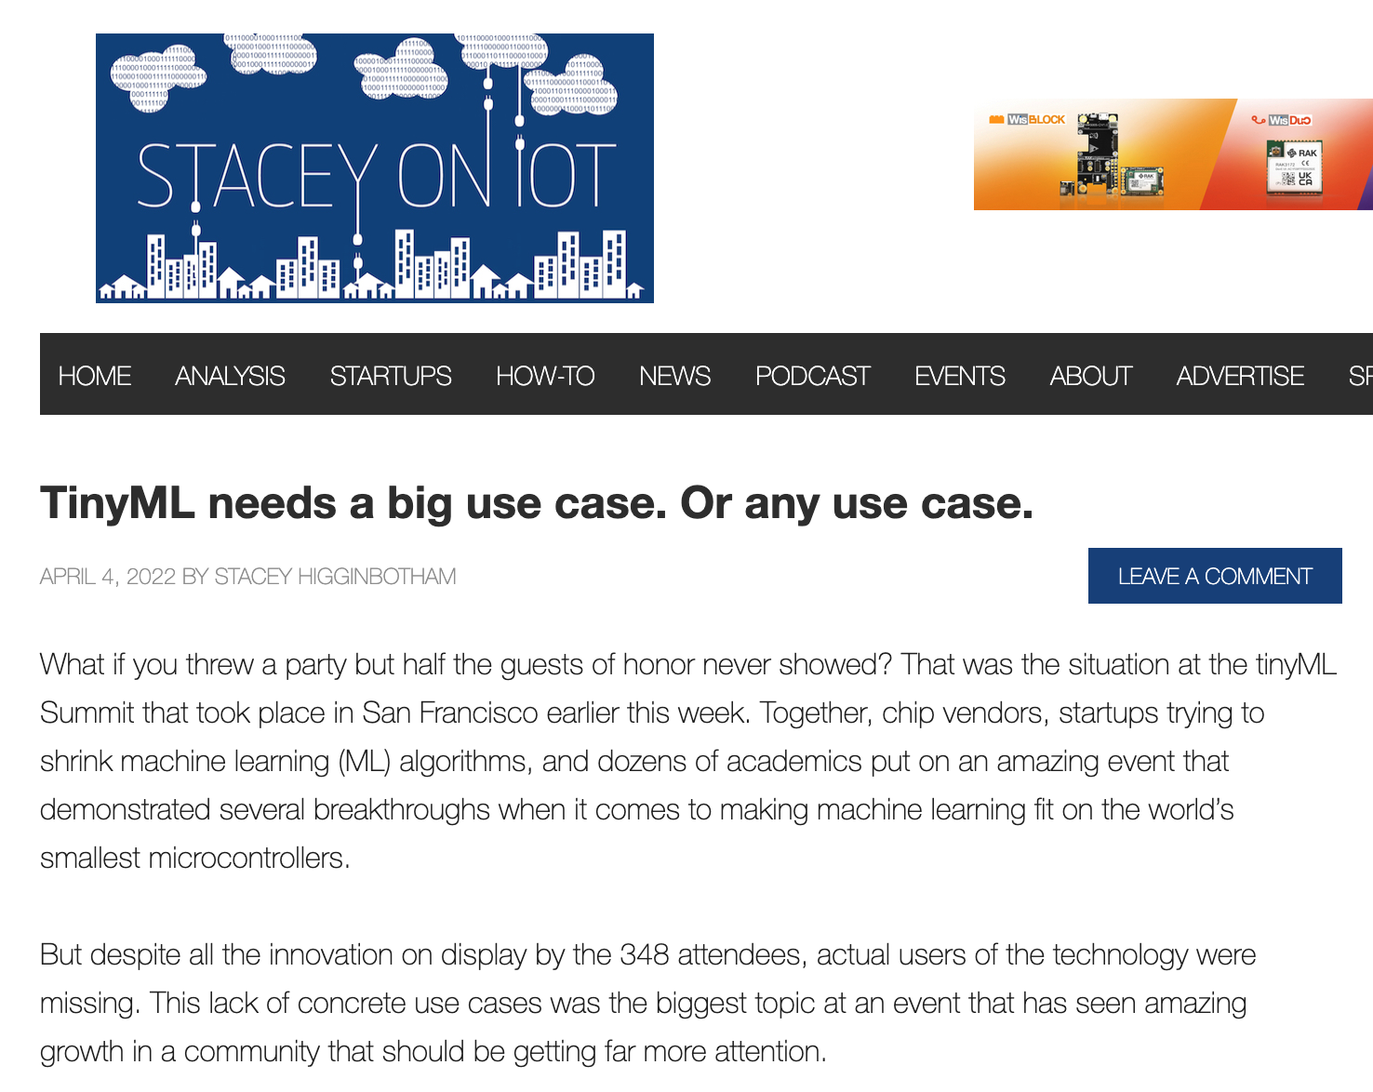

Slide 17
If we want to build a truly distributed Internet of Things with billions of sensors then we’re going to need TinyML.
Stacey Higginbotham – Stacey on IoT

Slide 18
As of today, machine learning is at its best when all we need are rough-ready results.

Slide 20
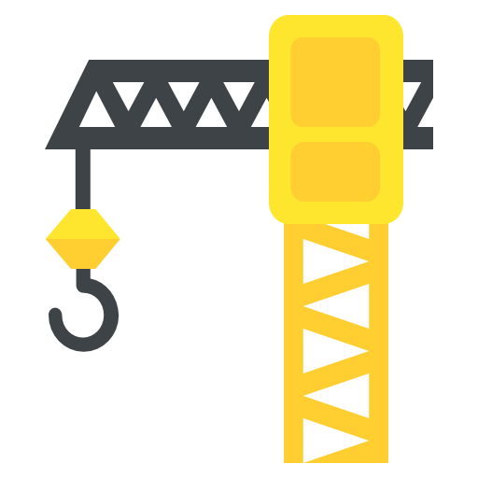
Reorient on the Fundamentals of TinyML
Privacy Protection
Power Conservation
Reduction in Latency of Results
Remove Need for “Always-On” Internet

Slide 21
Moore’s Law Isn’t Dead (Yet)

Slide 22
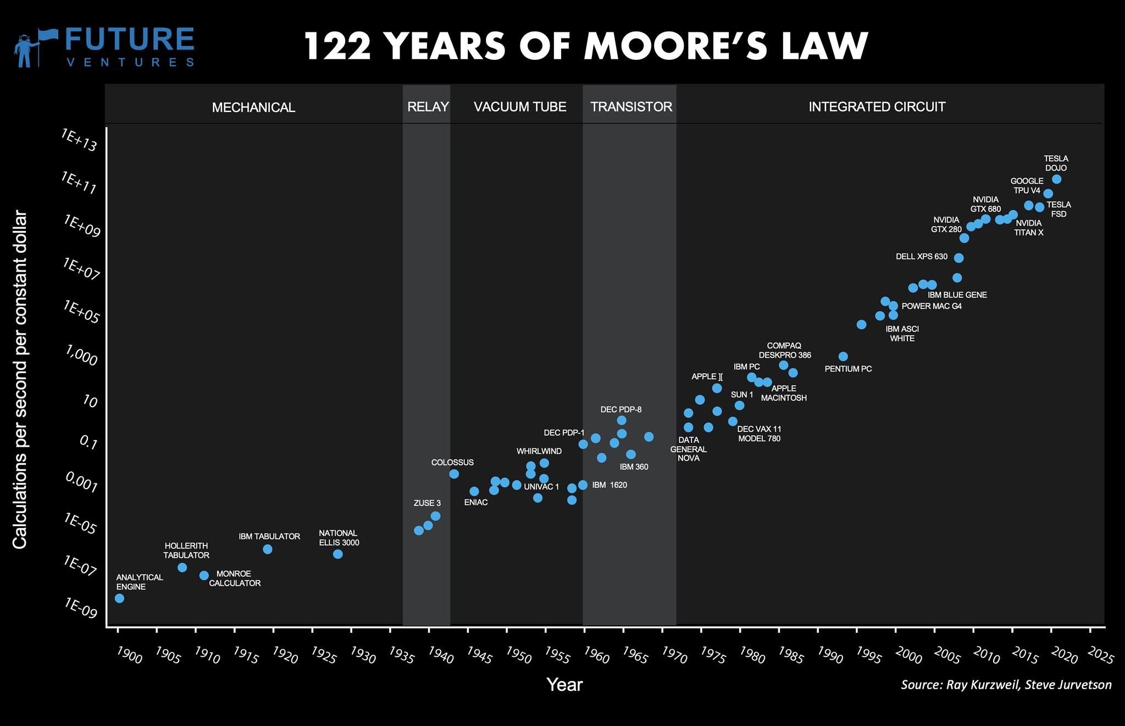

Slide 23
High(er) Bandwidth

Slide 24


Slide 25
Continuous Improvement
…Remotely

Slide 26
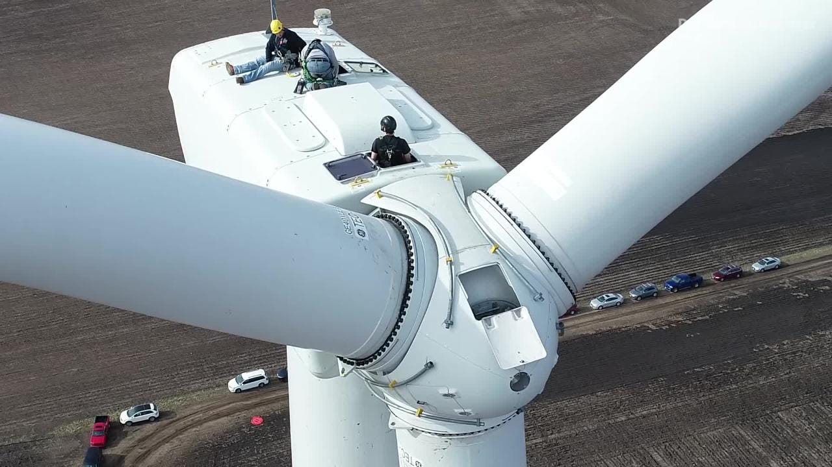

Slide 27
Speech Recognition

Slide 28
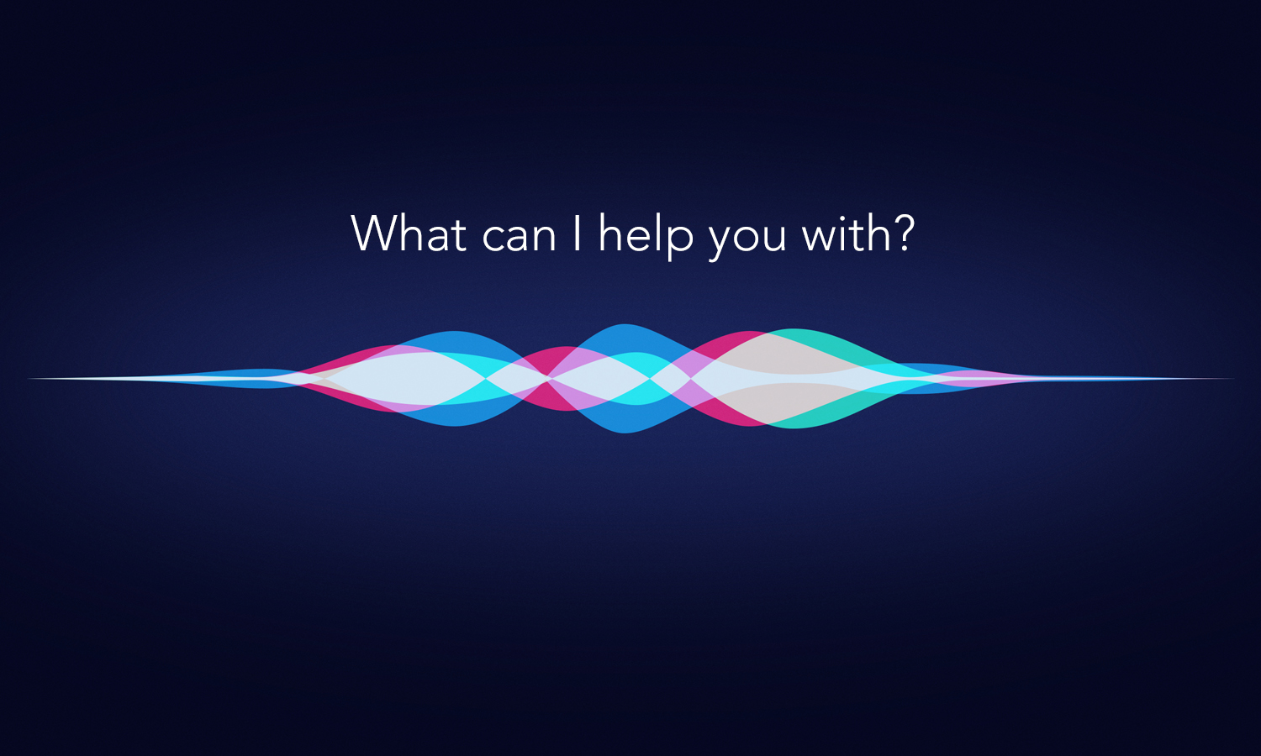

Slide 29
Predictive Maintenance

Slide 30
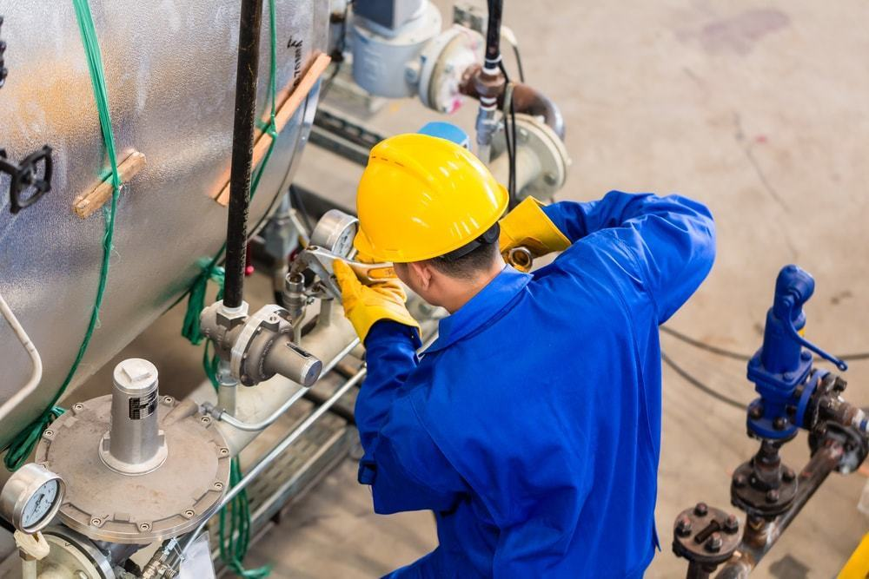

Slide 31
Customer Satisfaction

Slide 32
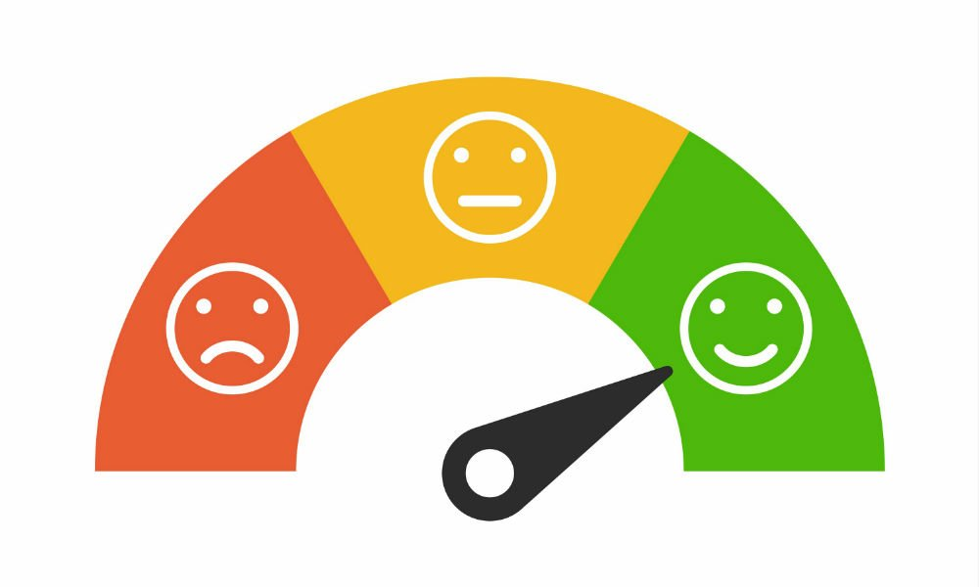

Slide 34
Lab! 🔨

Slide 35

Free Exploration!
Temp, Humidity, Motion Anomaly Detection with ML
Gesture-Detection Dashboard in [Ubidots/Datacake/Losant]
Sensor Dashboard in [AWS/Azure/GCP]
Hammer/Sword Battle with a Partner! ⚔️

